Slide 1
Can we predict the sale price based on Car parameters

Slide 2
Variables selected
There are total of 13 variables in my dataset. For my analysis, I’m considering below 6 variables. Correlation plays a key role in guessing the car price.
Name – Model name of the car.
Year – year when the car was bought.
Selling price – Selling price of the car during purchase.
Kms driven – No. of Kms driven in the car.
Fuel – Fuel Type of the car.
Mileage – Mileage of the car

Slide 3
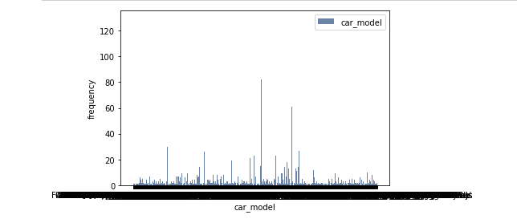
Model Name Histogram

Slide 4
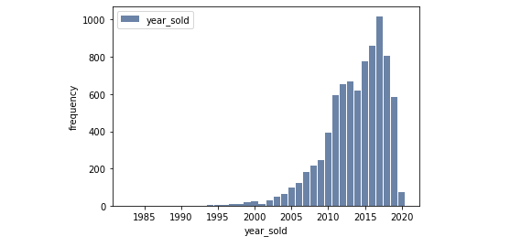
year_sold Histogram

Slide 5
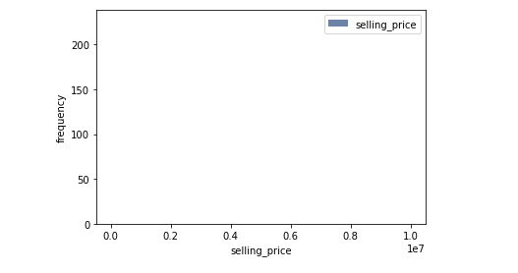
Selling_price Histogram
The plot is not clear here as the selling price values are large

Slide 6
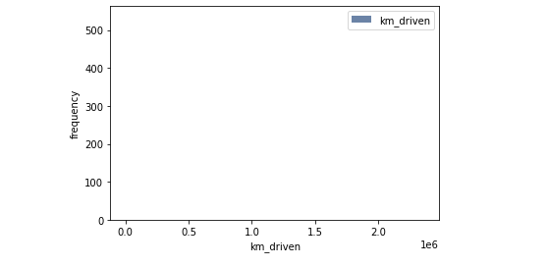
Km_driven Histogram
The plot is not clear here as the selling price values are large

Slide 7
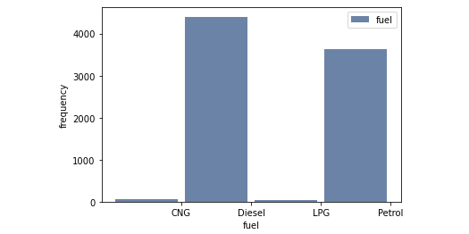
Fuel Histogram

Slide 8
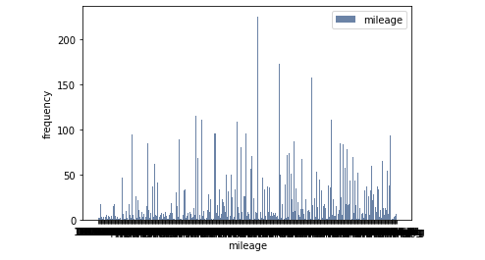
Mileage histogram

Slide 9
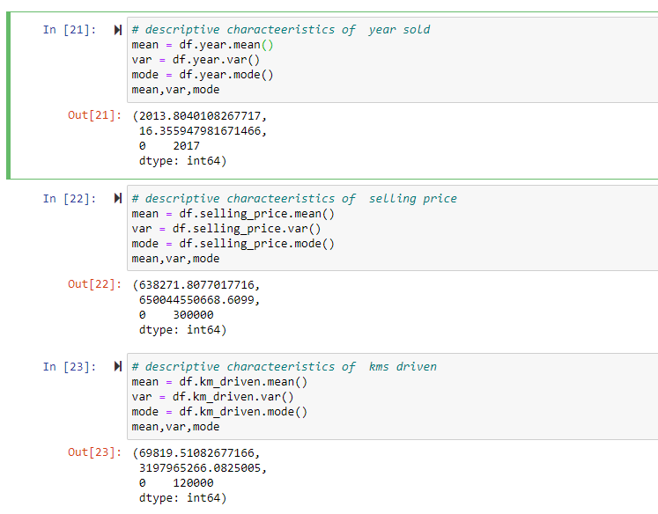
Descriptive characteristics of various fields

Slide 10
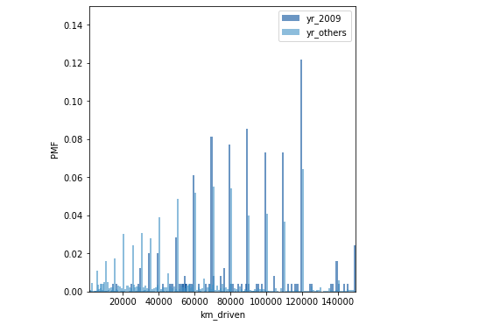
Kms driven in the recession year 2009 Vs Others

Slide 11
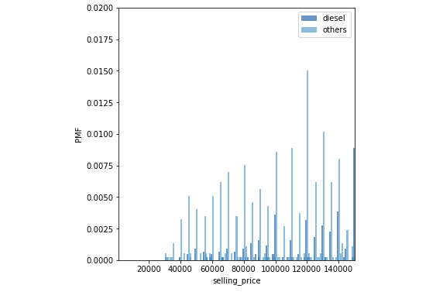
Selling price of Diesel Vs Other Cars

Slide 12
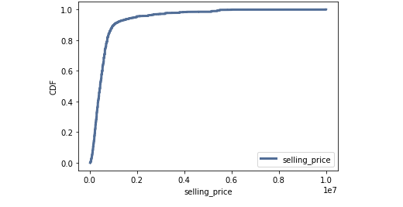
CDF of Selling price

Slide 13
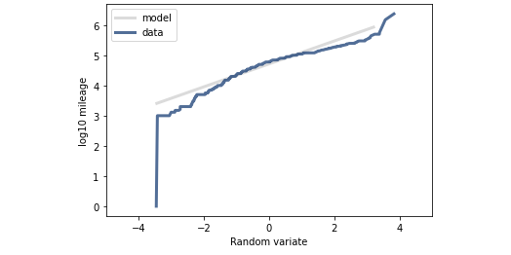
Normal probability plot of Mileage

Slide 14
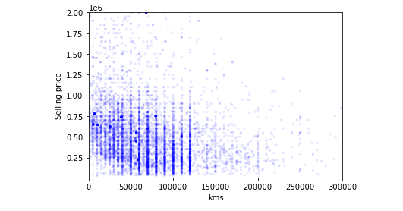
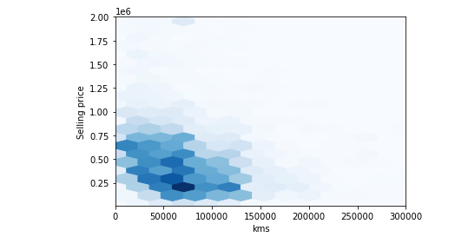
Kms Vs Selling Price Scatter plot

Slide 15
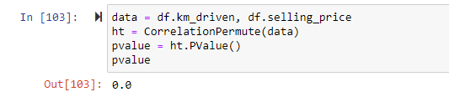
Hypothesis Test
The reported p-value is 0, which means that in 1000 trials we didn't see a correlation, under the null hypothesis, that exceeded the observed correlation. That means that the p-value is probably smaller than 1/1000 , but it is not actually 0.

Slide 16
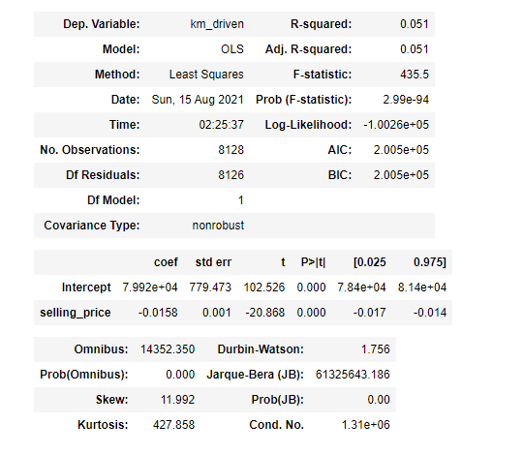
Regression Summary

